Slide 1
Critical Design Review
Residential Power Disagreggation Team 50
Team Members
Andrew Bailey, Ralph Cullom, Manny Harris, Labib Kasim
Mentor - Sponsor
Huangjie Gong - ABB

Slide 2
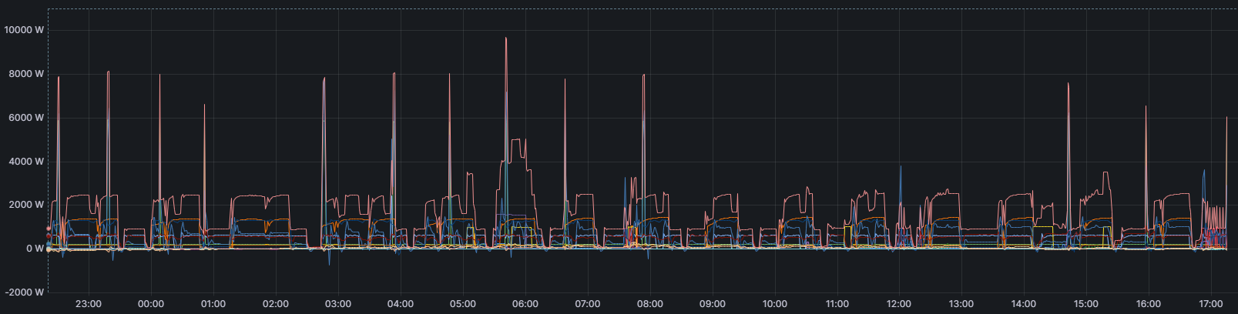
Project Introduction
Key features:
Device measures lumped power usage of a household.
Data that the device collects should be sent wirelessly back to online data storage through IoT.
Machine learning algorithms will take the data and weather as inputs and output the disaggregated loads and predicted use.
Measured and predicted data will be displayed to the user.
Key constraints:
Final cost of the product should be no more than $100.
Device shall be small enough to fit neatly inside the residential panel.
Notes:
Our project is creating a cost-effective, IoT-driven system to be employed by consumers which will disaggregate various residential loads. This device will incorporate machine learning and advanced data processing techniques to break down and forecast residential load across different categories based on the aggregated measurement, then display them for the user.

Slide 3
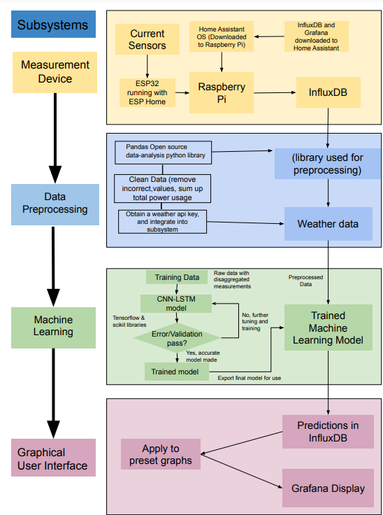
Functional Block Diagram

Slide 4
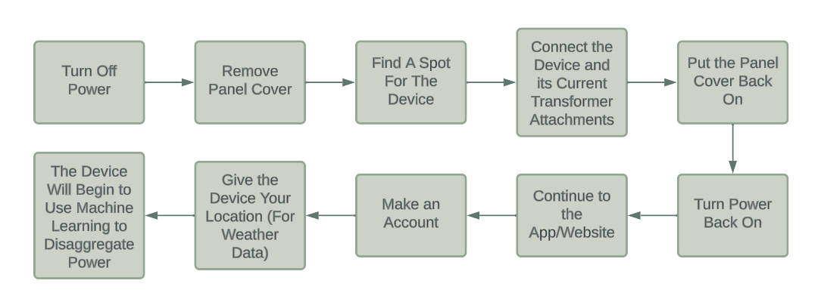
User Flow Chart

Slide 5
Subsystem Breakdown

Slide 6
Device Communication
Manny

Slide 7
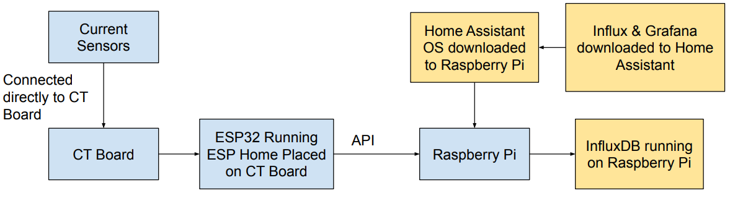
Hardware & Device Communication Block Diagram
ESP Home running on the ESP32 handles data transfer to Home Assistant.
Home Assistant Operating System is downloaded to raspberry pi. ESP Home and InfluxDB are addons to this OS.

Slide 8
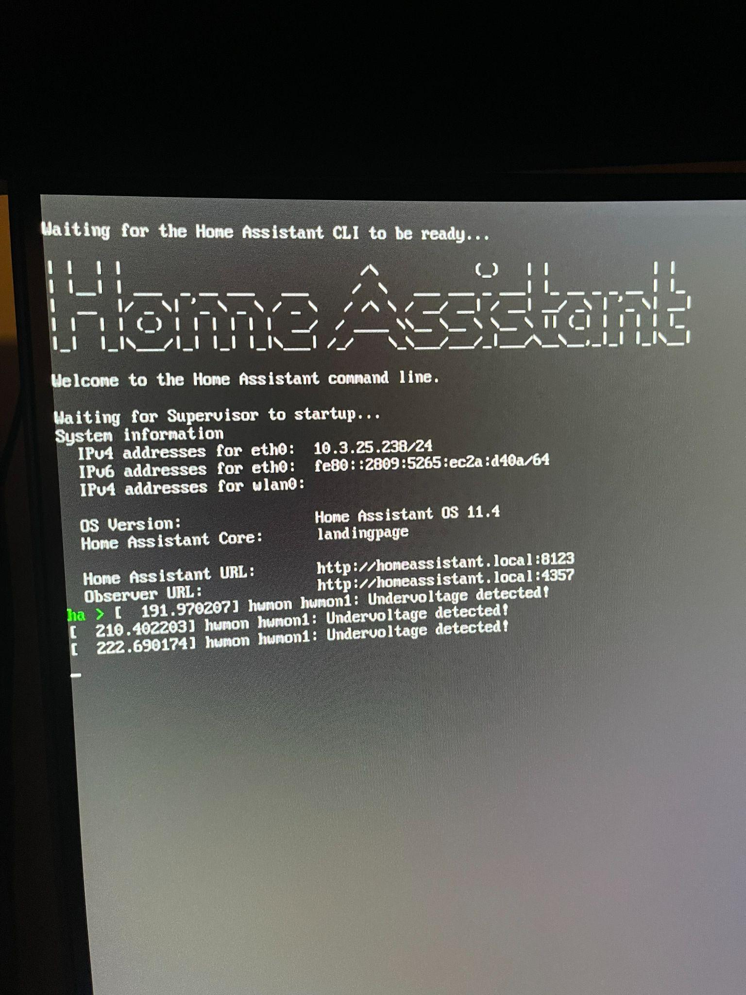
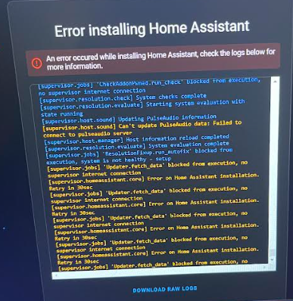
Home Assistant On Raspberry Pi

Slide 9
Bill Of Materials For Final Product
No fee associated with using influxDB running on Home Assistant
Two 100A/50mA current transformers @ $8.99 each = $17.98
House Energy Meter Kit = $54.99
2 channel Esp 32 energy meter board (PCB)
Power adapter for PCB
ESP32
Raspberry Pi 3 Model B = $35.00
Final Cost = $108
Wanted to be no more than $100

Slide 10
Machine Learning Model
Andrew

Slide 11
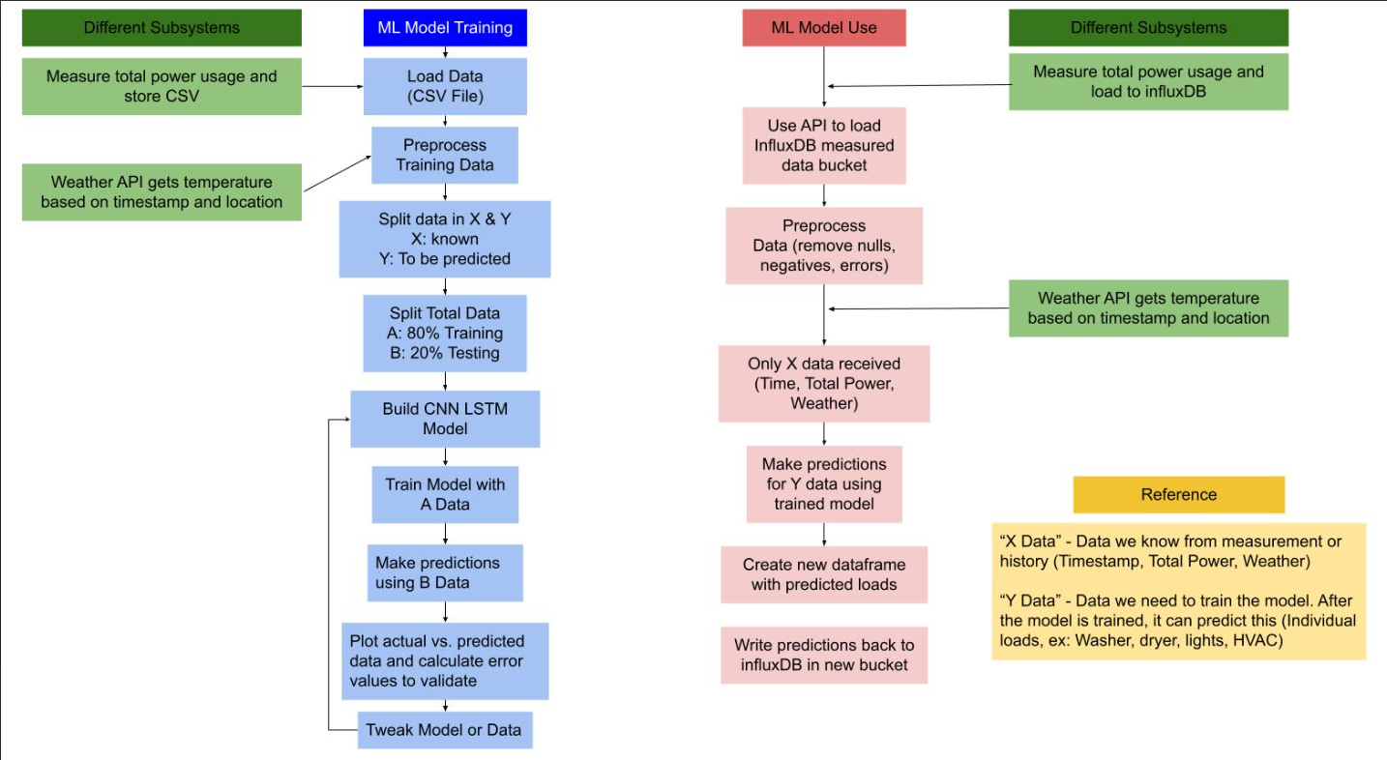
Subsystem Block Diagram
Notes:
Design challenges:
Reliable training data - We only have one reliable source for training data at the moment. Even with more sources for training data the model would not be generalizable without learning the power signatures each individual appliance uses. Using data containing only the signal of an appliances power usage could improve scalability.
Appliance efficiency or model - Different models of the same appliance will have differing power consumption and may be difficult to model based off signal profile or usage
Real time processing - Disaggregating data in real time could be very intensive for both the model and the hardware it runs on. Choosing a good interval for when to update data will reduce this load.
Validating the model - Even with the above mentioned method of validation, data that has never had part of it used for training will have to be used for model validation

Slide 12
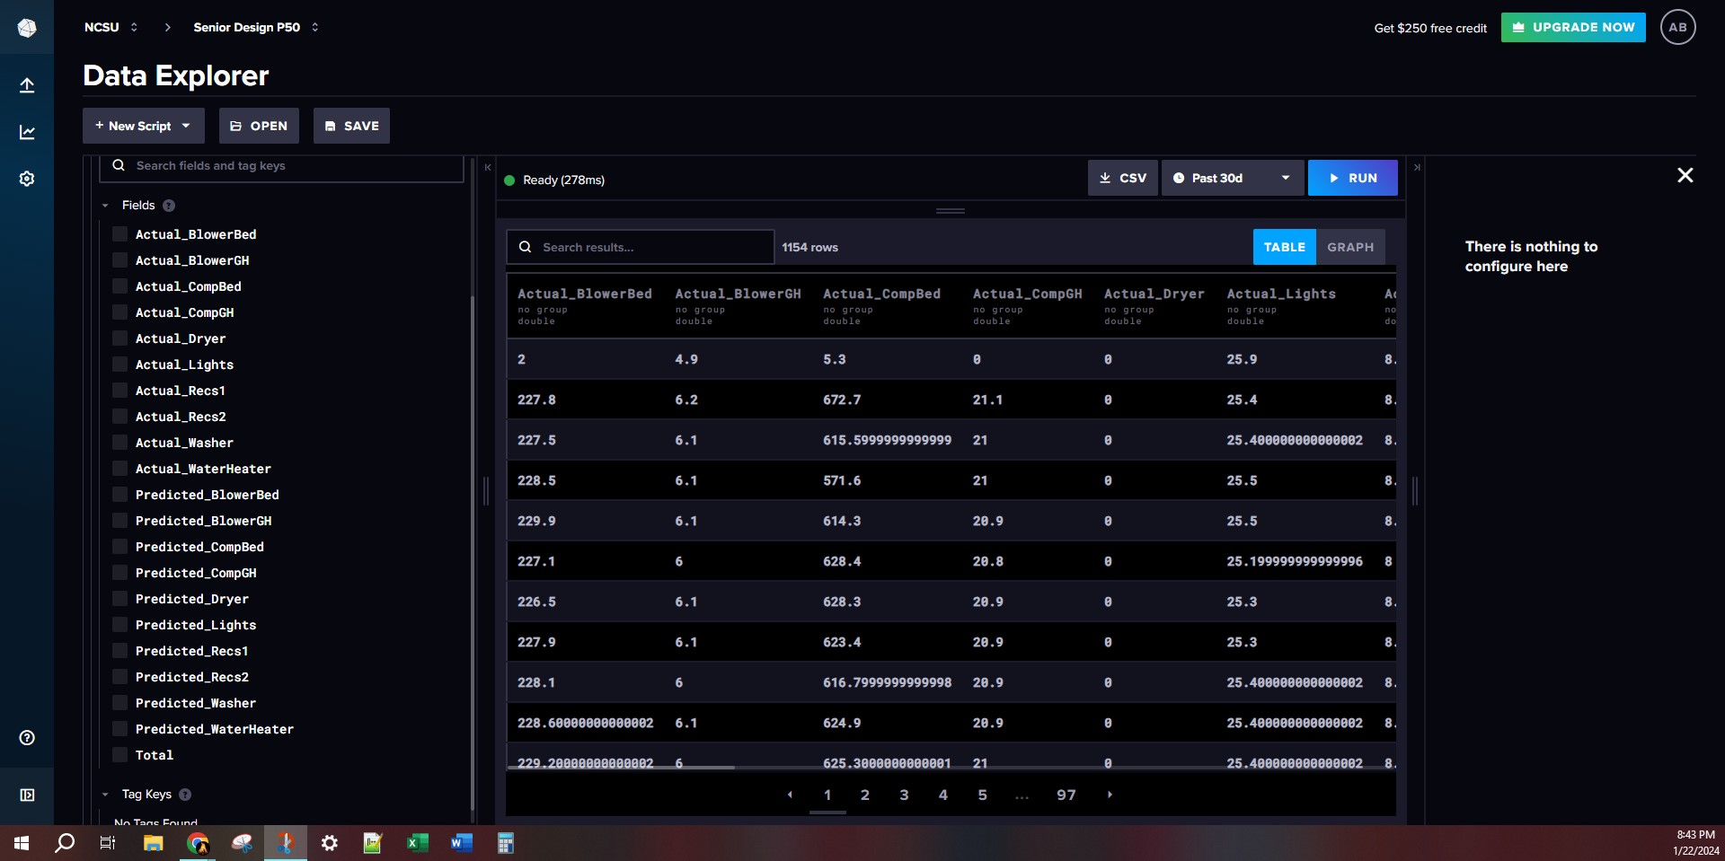
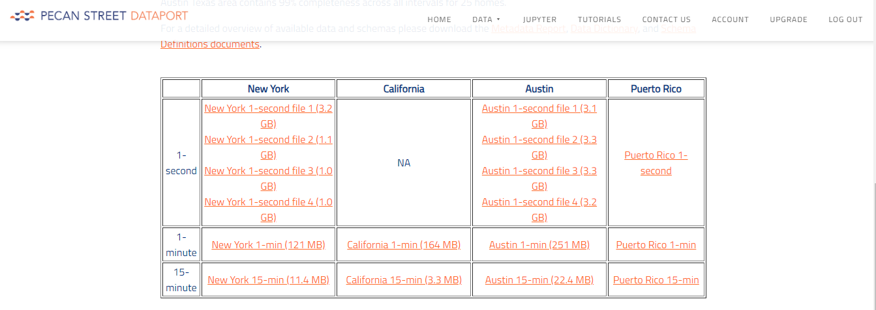
Machine Learning with InfluxDB
InfluxDB
CNN LSTM Model Writing to Influx
Reading Data From InfluxDB
Pecan Street CNN LSTM
Image

Slide 13
Machine Learning
Preprocessing and Weather API
Labib

Slide 14
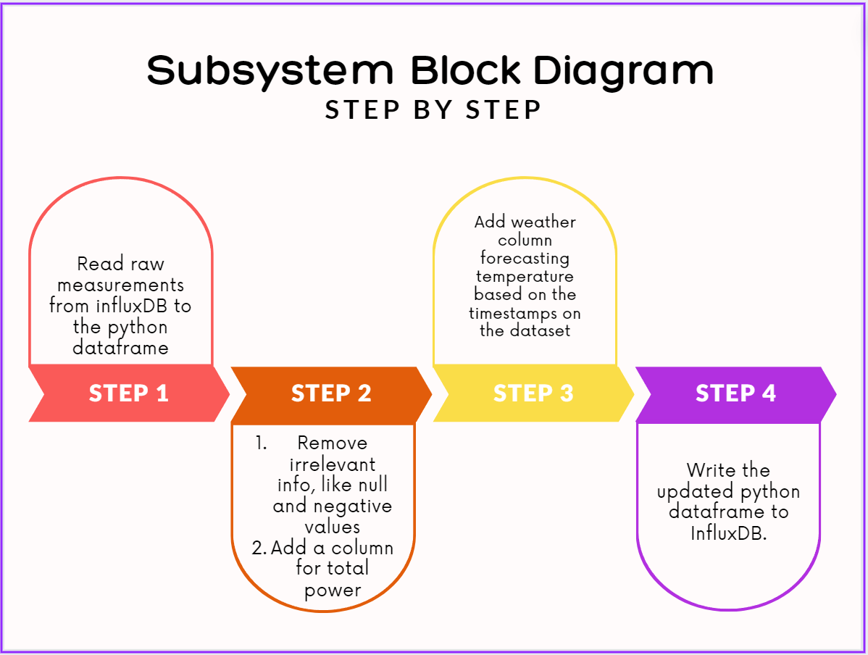

Slide 15
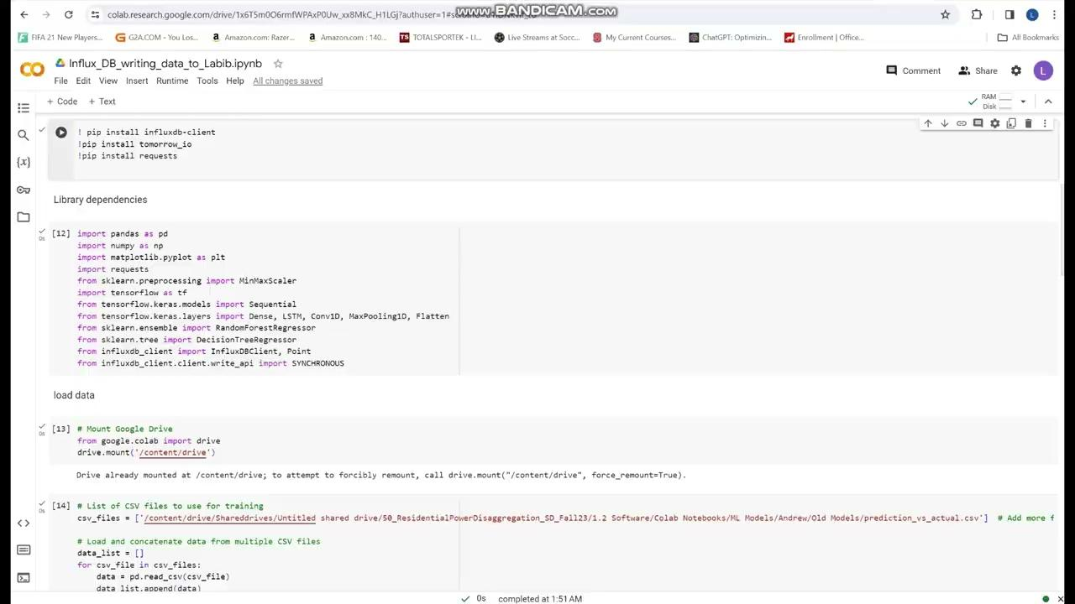
Link to the Colab File Link to the video:
https://colab.research.google.com/drive/1x6T5m0O6rmfWPAxP0Uw_xx8MkC_H1LGj?authuser=1#scrollTo=NPz1hi4GPs-j

Slide 16
Website/UI
Ralph

Slide 17
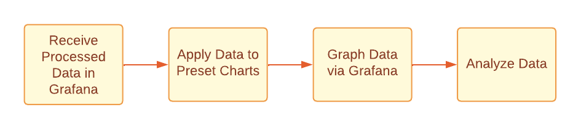
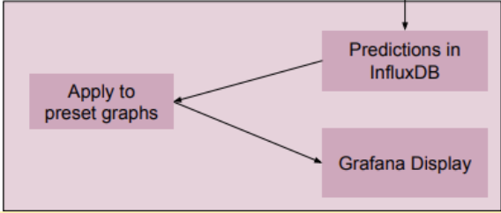
Subsystem Block Diagram
https://p50.grafana.net/d/ffb1a75a-f821-4b23-94e0-e043da9bcbf0/functioning-values-chart?orgId=1&from=1705892520000&to=1705961700000

Slide 18
Project Plan

Slide 19
Team Charter - 50_ResidentialPowerDisaggregationFall_2023
Roles
Timelines
Cost

Slide 20
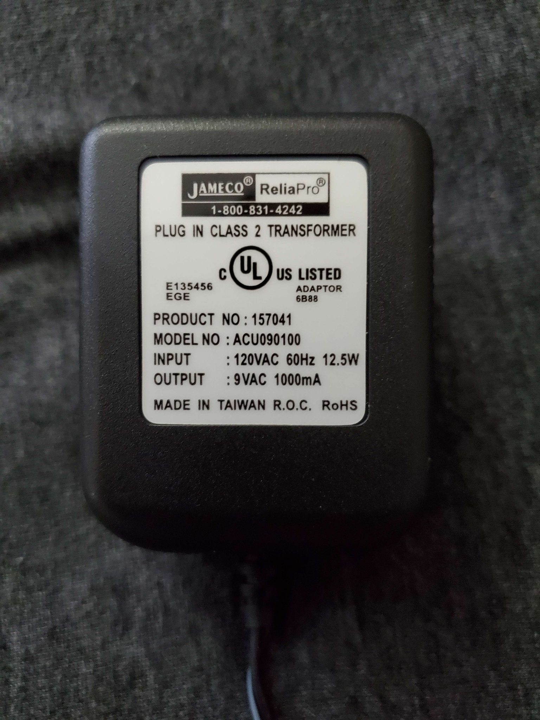
Power Usage
Jameco 120VAC/9VAC Transformer
Used to power the 6 Channel Measurement Boards
and the ESP-32
30 Day Power Usage
Total Usage - 10.08 kWh
Power Measurement Board - 6.48 kWh
Raspberry Pi - 3.6 kWh
Power Cost
Assuming $0.15 / kWh
Total Cost - $1.51 / month
Power Measurement Board - $0.97 / month
Raspberry Pi - $0.54 / month

Slide 21
Questions
and
Discussion
Notes:
Slide template from slides.com

